Slide 1
Automated Grading and Feedback Tool for Java
Team C – Street Coders

Slide 2
Team Members
Harish Babu Achanta
Siva Reddy Mekapothula
Vamshi Krishna Girikala
Prasanthi Rani Bhogaraju
Venkatesh Katragadda
Madanamohan Reddy
Sunil Kumar Sangaraju

Slide 3
Outline
Introduction
Project Briefing
Requirements
Use cases
Prototypes
Project Management Plan
Software Architecture
Implementation strategy
Effort estimation
Risks and Challenges

Slide 4
Introduction
Existing grading system of java programming assignments leads to problems like:
1. Time Consuming
2. Cost Consuming
3. Effort Consuming
4. Feedback not in a timely manner
Proposed system: Automatic Grading and Feedback Tool for Java

Slide 5
Project Briefing
Core Modules
Assignment Submission
Code Compilation and Validation
Design and Development of Test cases format and Validation Document
Grading and Feedback

Slide 6
Requirements
User Interface
The application should have a home page describing the application.
The application should have a user(Student & Intstructor) login page.
The application should have pages for student to view all the assignments,grades and feedback.
The instructor should have page to upload the test cases and validation documents and grade assignments.

Slide 7
Requirements (contd..)
Student Features
The student should have valid login credentials to login.
The student should have a page to view all the assignments along with grades.
The student should have an option to upload an assignment in zipped format.
The student should have different pages to view grades and feedback for each assignment.

Slide 8
Requirements (contd..)
Instructor View Features
The instructor should login to the application based on his role and his own login credentials.
The instructor page should have an option to upload the test cases and validation document.
The assignment should be automatically graded once the instructor clicks on the grad button associated with the assignment.
The feedback must be recorded and given to student.

Slide 9
Requirements (contd..)
Grading Process
When the instructor clicks the grade button the .Zip file should be extracted to a separate folder and java files are compiled and executed .
Input to the program is fetched from the file that has all the test cases uploaded.
Program is compiled & executed
If doesn’t compile – 50% mark deduction, and code validations are made

Slide 10
Requirements (contd..)
On successful execution, output is compared with the expected out
Grades and feedback is recorded into a excel sheet
Grades are based on the rubric
Grades are picked from instructor view & reflected in student view
Feedback that is recorded in the excel sheet will be attached in the student’s view for each and every student

Slide 11
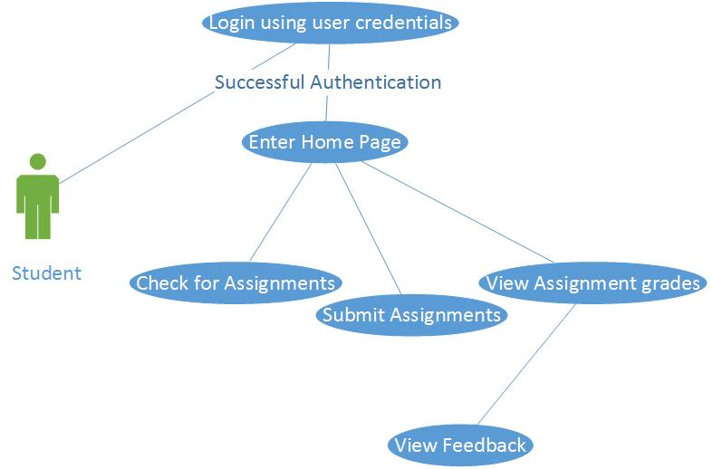
Use-case diagrams - student login

Slide 12
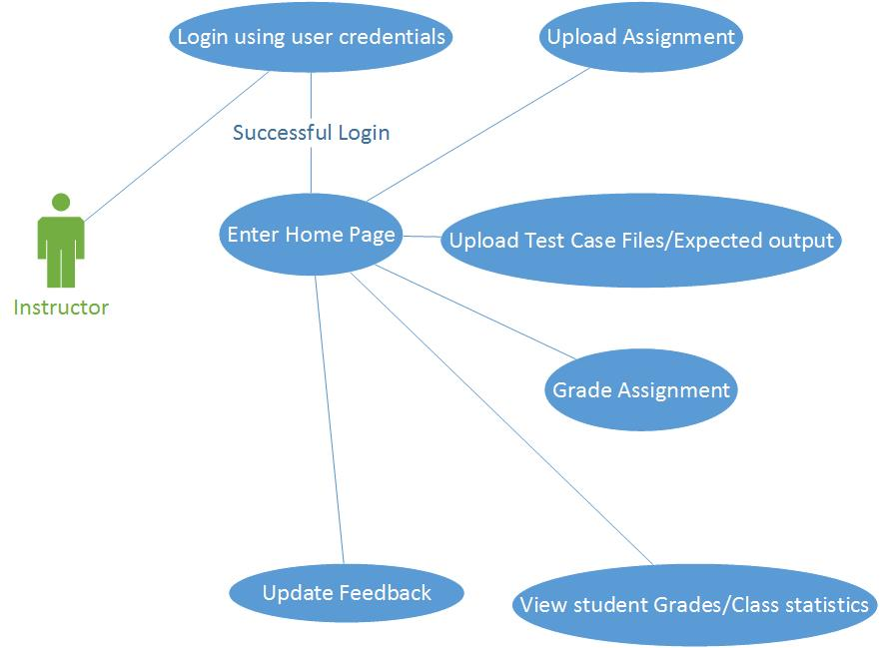
Use case - instructor login

Slide 13
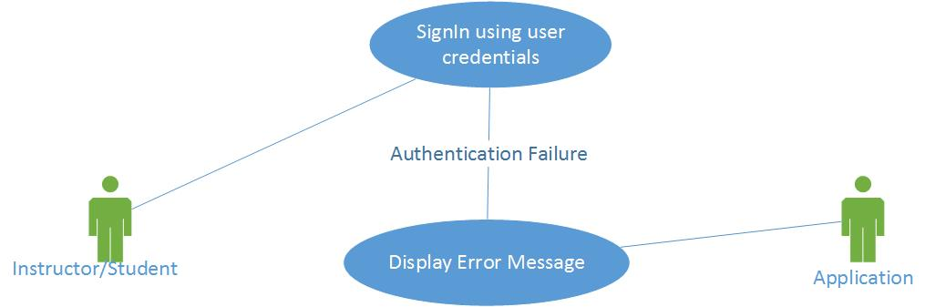
Use case - login failure

Slide 14
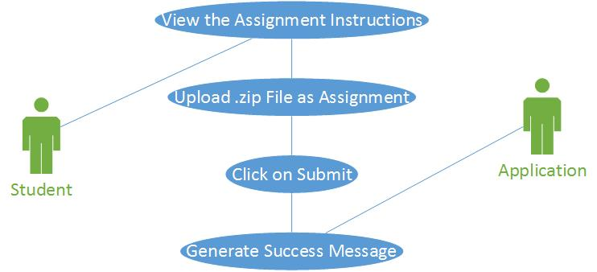
Use case - student successful file upload

Slide 15
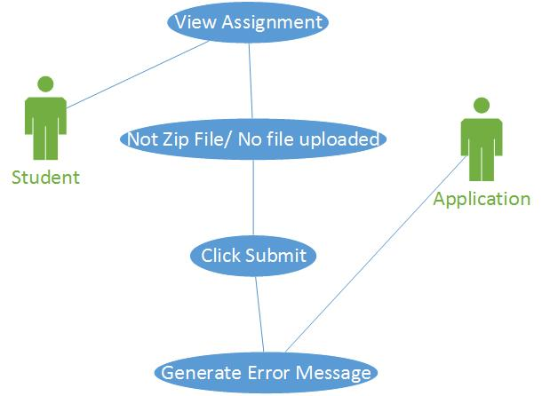
Use case - file upload failure

Slide 16
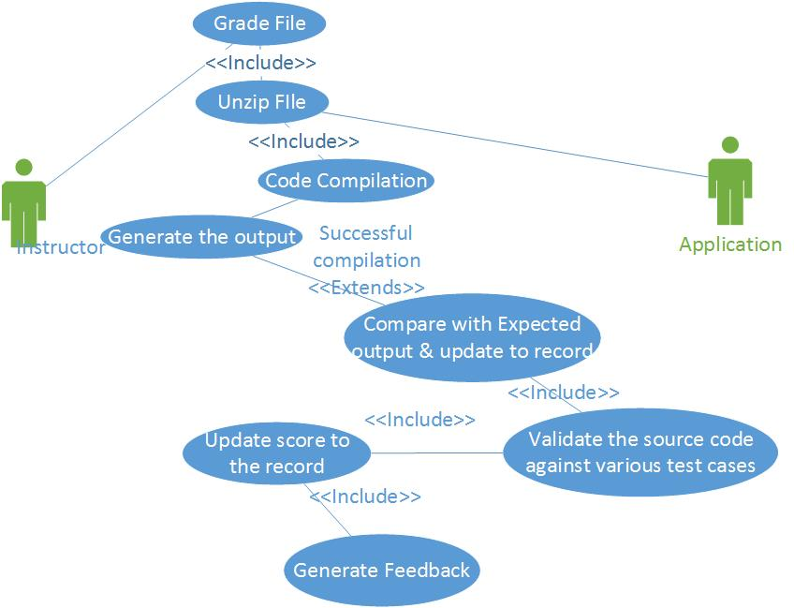
Use case- successful compilation

Slide 17
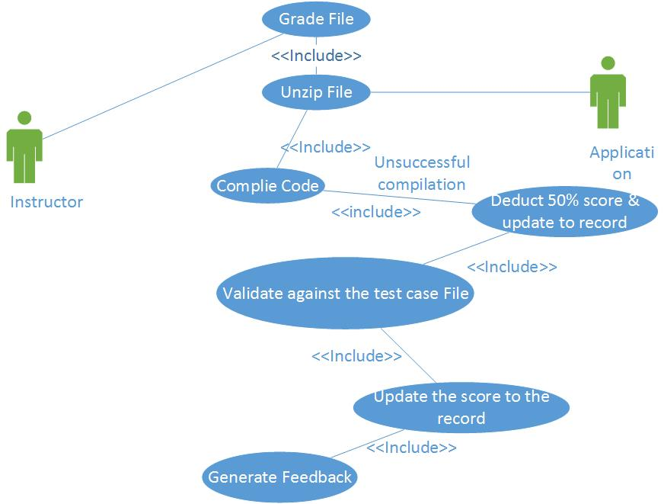
Unsuccessful compilation

Slide 18
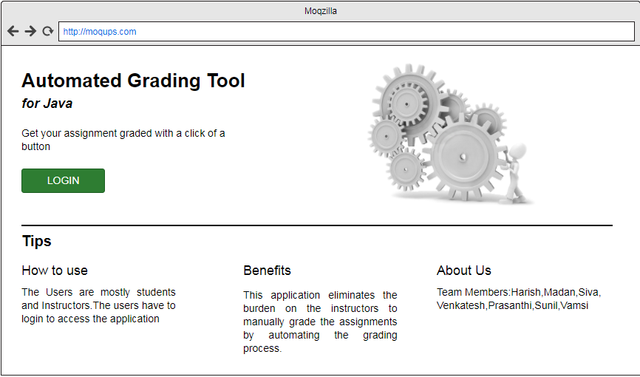
User Interface Prototype

Slide 19
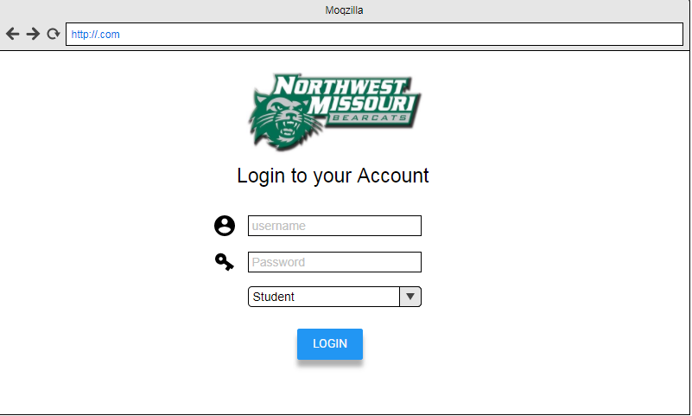
User Login Prototype

Slide 20
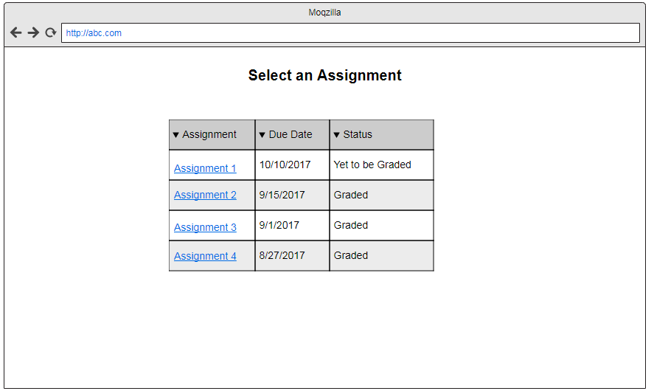
Assignment Overview

Slide 21
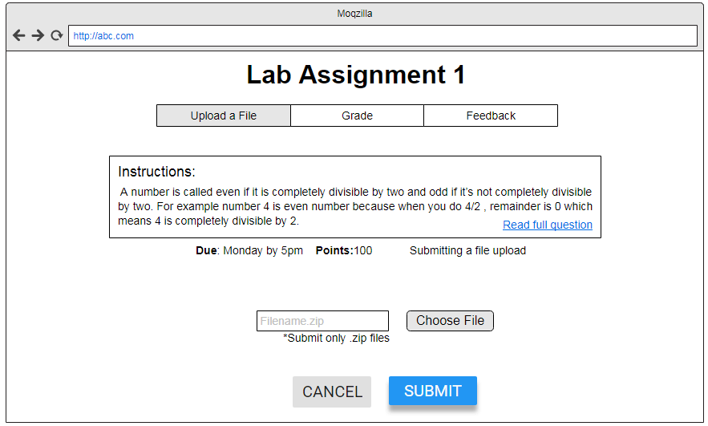
Upload the Document

Slide 22
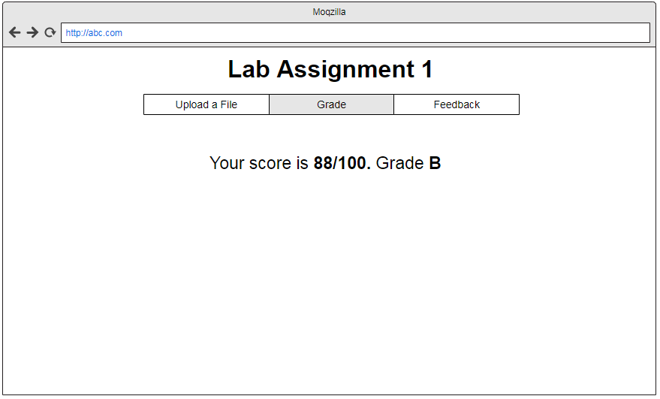
Viewing the Assignment Grade

Slide 23
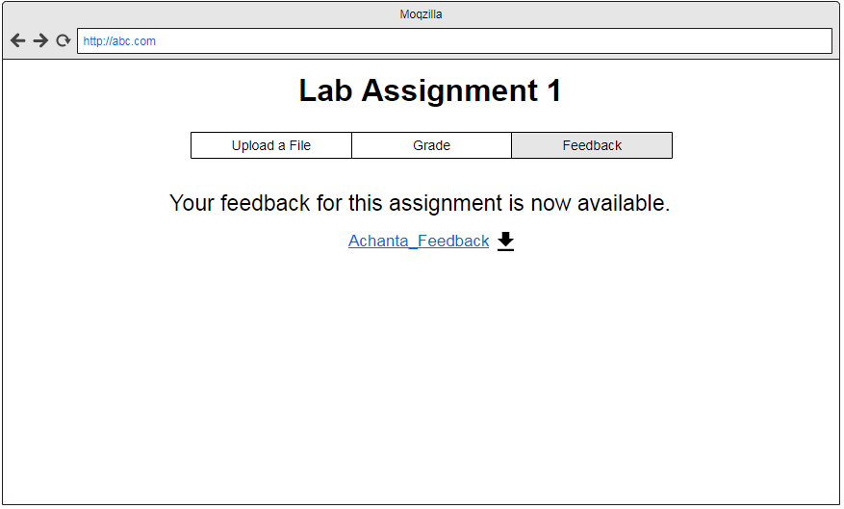
Assignment Feedback

Slide 24
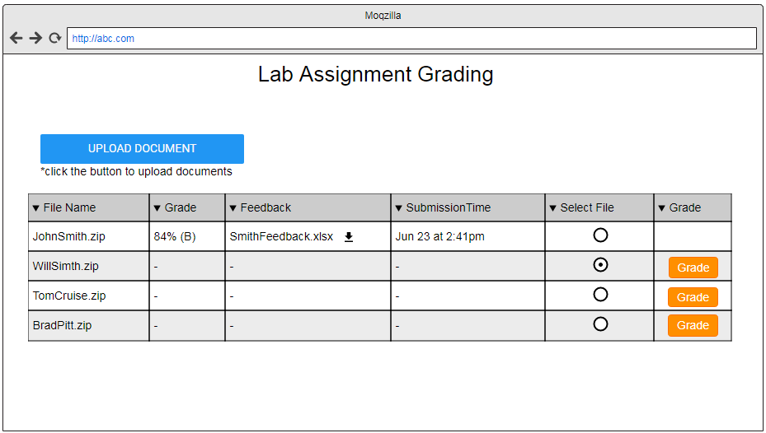
Instructor Grading the Assignment

Slide 25
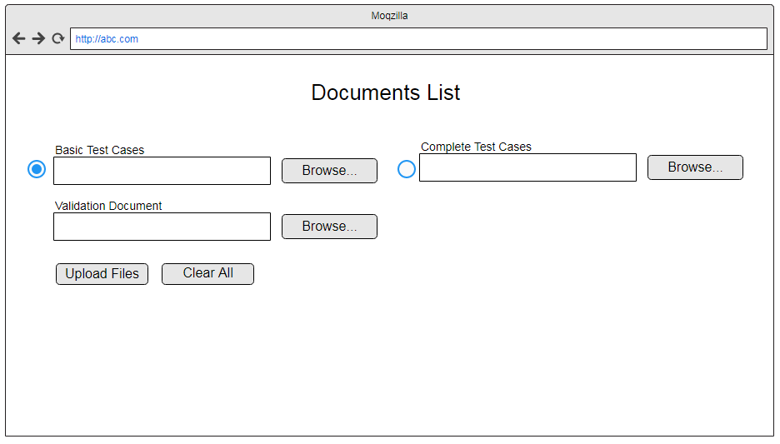
Upload the Test Cases

Slide 26
Project Management Plan
Scope Management Plan
Communication Management Plan
Cost Management Plan
Schedule Management Plan
Quality Management Plan
Risk Management Plan

Slide 27
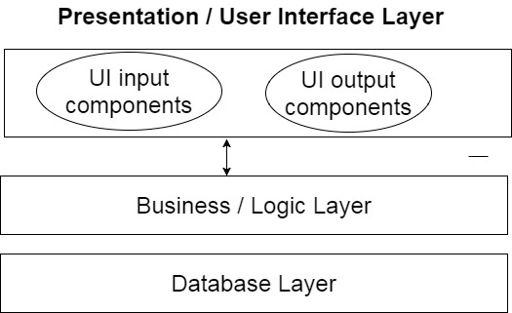
Software Architecture

Slide 28
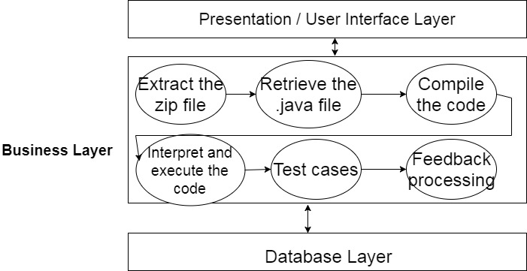
Software Architecture(contd..)

Slide 29
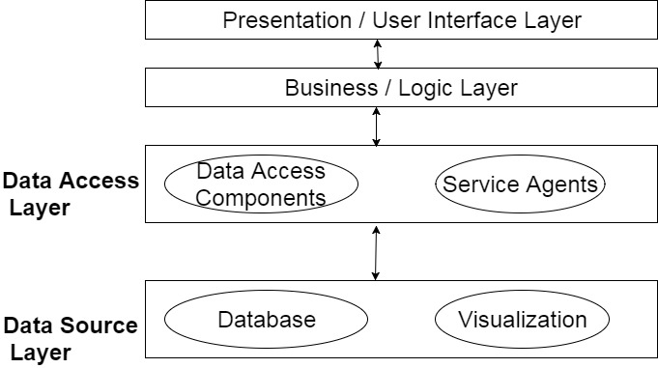
Software Architecture(contd..)

Slide 30
Implementation Strategy
Firstly we will gather all the tools that are compatible with both the UI and Operating system.
We will set up the appropriate database and build the user interface to understand the look and feel of the project.
We will develop a basic functionality for a student to upload the .zip file and get it automatically extracted and execute the class files to generate output.
Finally,we will integrate the feedback module to record all the errors and deduct the score and assign the final grade.

Slide 31
Effort Estimation
Estimated amount of code: 5000 to 7000 LOC
Each team member will spend 15 hours per week in GDP II
Team will contribute around 3150 hours for GDP I and GDP II
Each team member will write 8 lines of code per day which is correct, commented, documented and bug free code
Will complete the project by the end of 12th week of GDP II

Slide 32
Risks and Challenges
Team Member Expertise.
Validating code for different test cases
Writing Heuristics for checking the program structure.
RISK MANAGEMENT
Handling sudden absence of team members and work reallocation

Slide 33
Thank You!!

